Slide 1
Uptight Database Security
Ronald Dameron (@RonDBA)
ron.dameron@gmail.com

Slide 2

About Me
Notes:
I have a distant cousin in the Rebel Alliance.
I’m the Only DBA for a small software company. The cloud takes up most of my time now.
Why am I “The Only DBA”? The boss called me that at the last SQL Saturday in Tampa.
I’m on a Twitter mostly. I tweet about a lot of different stuff. IT, SciFi, Softball, books I’ve read, A-10 Warthog, etc.
I have successfully done my first git pull request for Brent Ozar’s First Responder Kit.
Keep learning.

Slide 3
Agenda
Why?
Sysadmin always required?
Six steps plus some assumptions
Demo
Resources
Q&A
Notes:
How many DBAs in the room? Developers, Managers? Poll
Big company or small company?
Anybody running SQL Server 2000?
What version of SQL Server are you running currently?
If you are still running SQL Server 2000 or prior, nothing to see here.
Please upgrade. It’s out of support. My condolences if you are still stuck supporting it.
I’m open to questions while I’m presenting.

Slide 4
What is a DBA?
Default Blame Acceptor
Don’t be one.

Slide 5
I never want to be this DBA…
Notes:
If that doesn’t send a chill down your spine, nothing will.
Initially, I pushed back for a couple of years because I thought it would be a royal pain to do DBA work without sysadmin.
We still had a lot of SQL Server 2000 at the time also.
The fact that SQL Server 2014 will have this type of role built-in validates this work.
I thought this would be harder.
It’s still viable given how long it takes a company to adopt the latest version.
This is the initial notification of the breach that Anthem sent to it’s associates. I will show you on the next slide why this is so scary.

Slide 6
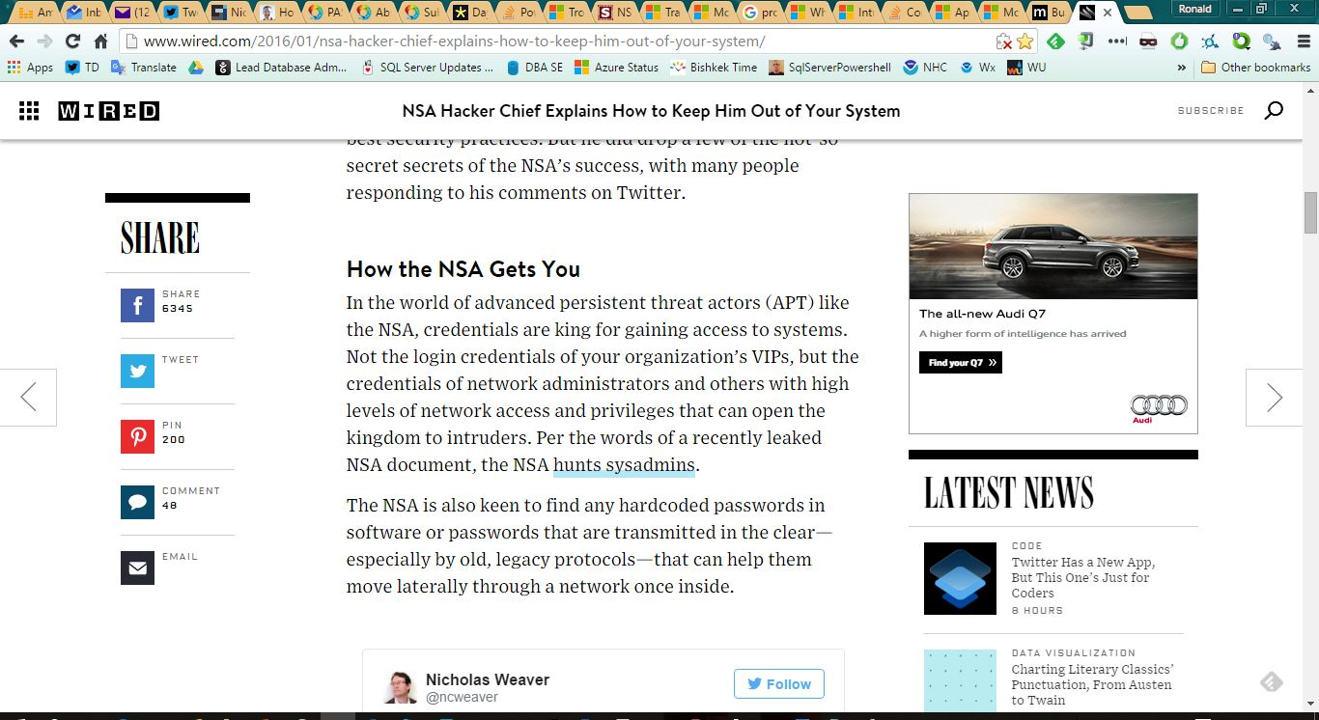
Listen to the NSA…
http://www.wired.com/2016/01/nsa-hacker-chief-explains-how-to-keep-him-out-of-your-system/
Notes:
Hackers love sysadmin credentials too.
Rob Joyce, Head of NSA TAO team spoke at Usenix Security conference in SF in January 2016

Slide 7

Why?
http://www.startrekmovie.com/images/gallery/gallery_07.jpg
http://www.wpsdlocal6.com/story/28037861/anthem-hack-what-steps-to-takea
Notes:
Does your company control SQL Server DBA’s sysadmin access?
How many DBAs have sysadmin access?
How big is your company?
It is becoming increasingly difficult to allow DBAs to retain sysadmin permission 24x7x365 due to IT Security Audit and Compliance concerns.
Do you have a Risk, Compliance, or Audit team questioning this access?
I’ll bet they are now at Anthem.

Slide 8
Why?
Decreased risk
Auditors don’t like AlwaysOn sysadmin
More control of Production databases
Sysadmin only when needed
Another defensive layer
Notes:
Make the hacker’s life more difficult.
Hackers love privileged accounts.
Does your company control SQL Server DBA’s sysadmin access?
How many DBAs have sysadmin access?
How big is your company?
It is becoming increasingly difficult to allow DBAs to retain sysadmin permission 24x7x365 due to IT Security Audit and Compliance concerns.
Do you have a Risk, Compliance, or Audit team questioning this access?
I’ll bet they are now at Anthem.
Talk about why this was done at Metlife. Tell the whole story.

Slide 9
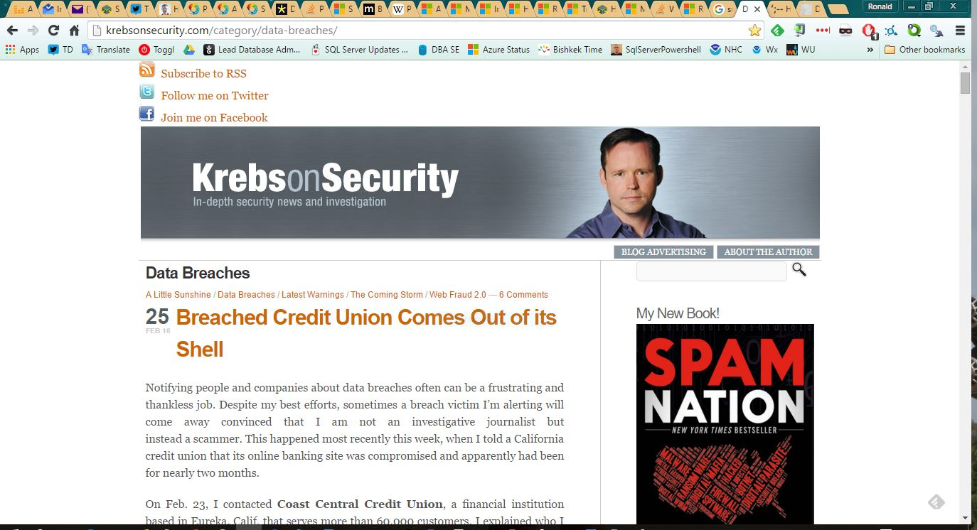
Data breaches
Notes:
Brian Krebs

Slide 10
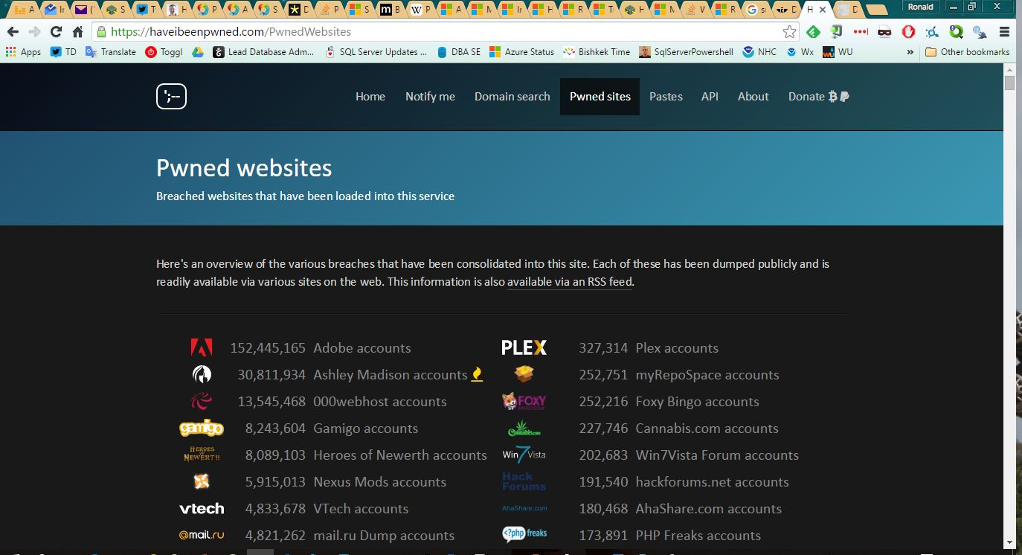
Have you been pwned?
Notes:
Troy Hunt

Slide 11
Why? You don’t want to be this DBA.
http://krebsonsecurity.com/2015/02/china-to-blame-in-anthem-hack/
Notes:
Initially, I pushed back for a couple of years because I thought it would be a royal pain to do DBA work without sysadmin.
We still had a lot of SQL Server 2000 at the time also.
The fact that SQL Server 2014 will have this type of role built-in validates this work.
I thought this would be harder.
It’s still viable given how long it takes a company to adopt the latest version.
This is the initial notification of the breach that Anthem sent to it’s associates. I will show you on the next slide why this is so scary.

Slide 12
Requirements
Sysadmin access only when needed
DBAs don’t have access to user databases
Notes:
Need sysadmin: Deployments, Incidents, DR tests

Slide 13
Sysadmin Required?
sp_configure
Zero parameters?
One parameter?
Two parameters?
RECONFIGURE?
Notes:
Execute permissions on sp_configure with no parameters or with only the first parameter are granted to all users by default.
To execute sp_configure with both parameters to change a configuration option or to run the RECONFIGURE statement, you must be granted the ALTER SETTINGS server-level permission.
The ALTER SETTINGS permission is implicitly held by the sysadmin and serveradmin fixed server roles.
RECONFIGURE permissions default to grantees of the ALTER SETTINGS permission. The sysadmin and serveradmin fixed server roles implicitly hold this permission.

Slide 14
Sysadmin Required?
Kill a process?
View SQL Server errorlog?
DBCC CHECKDB?
Notes:
KILL
SQL 2012, 2008, 2008 R2
Requires the ALTER ANY CONNECTION permission. ALTER ANY CONNECTION is included with membership in the sysadmin or processadmin fixed server roles.
SQL 2005
Requires membership in the sysadmin and processadmin fixed database roles.
AND???
ERRORLOG
A bit of a PITA to nail down exact perms.
sp_readerrorlog, xp_readerrorlog?
Books Online?
Under Log File Viewer topic.
http://msdn.microsoft.com/en-us/library/dd206996(v=SQL.100).aspx
Requires membership in the securityadmin fixed server role.
DBCC CHECKDB
Requires membership in the sysadmin fixed server role or the db_owner fixed database role.

Slide 15
Sysadmin Required?
Select queries on DMVs?
Update DMVs?
Notes:
VIEW SERVER STATE to view DMVs
To query a dynamic management view or function requires SELECT permission on object and VIEW SERVER STATE or VIEW DATABASE STATE permission. This lets you selectively restrict access of a user or login to dynamic management views and functions. To do this, first create the user in master and then deny the user SELECT permission on the dynamic management views or functions that you do not want them to access. After this, the user cannot select from these dynamic management views or functions, regardless of database context of the user.
Update DMVs – trick question. Paying attention?
So, do we really need sysadmin all the time going forward?

Slide 16
Assumptions
You have an audit tool
Patching done regularly
Password vault
Separation of Duties
Notes:
Guardium
Cyber-Ark password vault
Size of company could be a factor
Separation of Duties: DBAs do not manage logins.

Slide 17
Implementation
Small company
Two logins
Large company
Privileged Identity Manager

Slide 18

Hopefully, you have a security audit tool…
Notes:
Hopefully, you have something monitoring your environment for incursions and vulnerabilities.

Slide 19
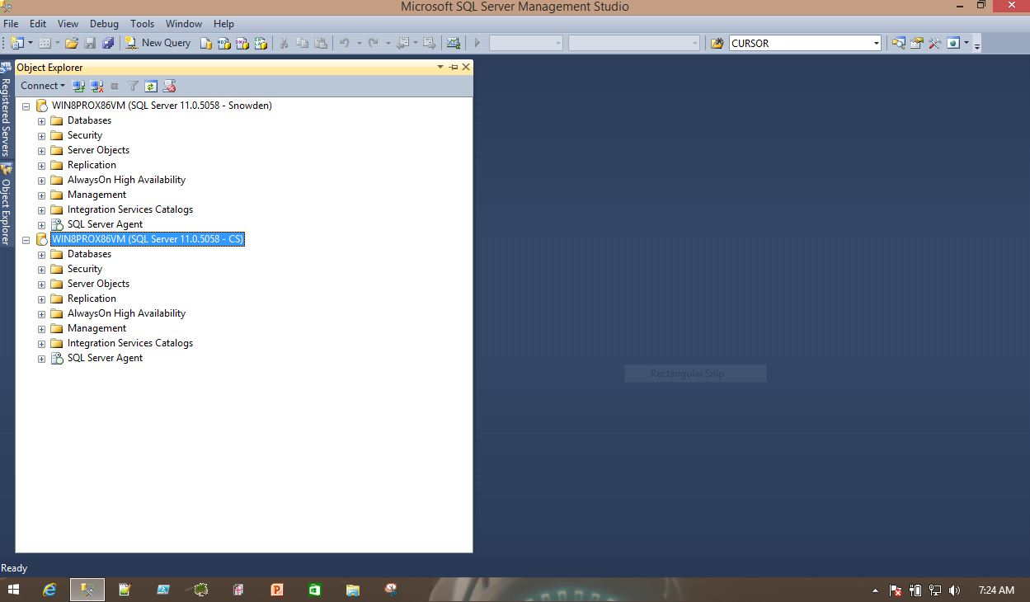
What’s the difference?
Notes:
Who is sysadmin and who is not?

Slide 20
Offshore DBA – Simple Example
Db_Datareader on 2 databases
ALTER ANY EVENT SESSION
ALTER TRACE
CONNECT SQL
VIEW ANY DATABASE
VIEW ANY DEFINITION
VIEW SERVER STATE
Notes:
Offshore DBA permissions at current job.
Job responsibilities for PRODUCTION:
Outage troubleshooting
Familiarization with PROD environment
READ ONLY
Further proof that you don’t always need to be sysadmin
I am sure it could be other permissions - we should be fine as long as it is read-only and/or diagnostic related.

Slide 21
To lockdown a database…
sp_foreachdb
Add controlled sysadmin group
Reduce permissions to existing DBA groups
Deny access to user database schemas
Drop DBA groups from sysadmin server role
Grant DBAs additional memberships
Notes:
6 steps needed to lock down databasess.
First, We need to contrast two important concepts.
This works because of CONTROL SERVER permission and granular permissions
Sysadmin cannot be denied. It bypasses the permission check algorithm.
CONTROL SERVER allows DENYs.
Microsoft SoD white paper says, “Do not use sysadmin as general purpose DBA role.” It says that in the white paper. Really.
Sysadmin can perform any activity in a database instance
db_owner also bypasses permission checks
Don Kiely called CONTROL SERVER “Virtual Sysadmin” during his talk at 2012 PASS Summit
HUGE TAKEAWAY!
Permissions can be denied!
Can’t deny permissions from sysadmin
If you only remember one thing, this is it.
This is the core of what makes this all possible.
Now, I’ll review each of these steps in detail.

Slide 22
sp_foreachdb
Created by Aaron Bertrand
Replaces sp_MSforeachdb
sp_MSforeachdb skips databases
That’s a feature. ;-)
Added Exclude parameter
Notes:
Step 1.
Create sp_foreachdb in master database
Aaron Bertrand’s sp_foreachdb is a prerequisite.
Did you know about the bug in sp_MSForEachDB?
Link to Aaron’s post on this issue.
I modified so I could exclude my DBA utility database.
Do you have a DBA utility database at your workplace on each server?
Highly recommended best practice
Start off with Ola’s scripts
Do you know who Ola is?
I just had to duplicate some of his code
Duplicated a CTE
He uses FOR XML PATH(‘’) instead of a cursor. Which I have heard is a good way to avoid a cursor but I haven’t tried it yet nor implemented in my parts of this script.
Added another clause to CASE statement for exclude list.
I only made a couple simple changes. This has been working in my production environment for the past year.

Slide 23
Add a controlled sysadmin group
Controlled access
Requires change or incident ticket for access
Notes:
Step 2. Add PIM DBA groups to sysadmin server role
For elevation purposes, we have a group of ids on each server that are maintained in a Privileged Identity Manager. You need an approved change ticket to access the vault to get an id/password.
I have multiple domains in my environment that need to be managed.
Have to add the AD groups to the sysadmin role on each server.
I thought this was a neat trick. THANK YOU, GOOGLE.
(SELECT STUFF(SUSER_SNAME(), CHARINDEX('\', SUSER_SNAME()), LEN(SUSER_SNAME()), ''))= 'DomainName‘
But I found a mistake in my code where I check version numbers while prepping for this event. Another good reason to participate in SQL Saturday.

Slide 24
Reduce DBA permissions
CONTROL SERVER
DENY ALTER ANY LOGIN
DENY ALTER ANY CREDENTIAL
GRANT CREATE ANY DATABASE
DENY ALTER ANY SERVER ROLE
Did I miss anything?
DENY IMPERSONATE
Notes:
Step 3. Grant minimum permissions needed to existing DBA groups for new MSSQL Security model
Mind the gap: DENY IMPERSONATE
I caught this gap after the initial implementation. I had to fix something on a box that I was locked out of. I realized that I hadn’t denied this permission and was able to resolve the issue. Bob Beauchemin pointed it out after I did my presentation for the Security VC.
I’m kind of glad I didn’t deny this initially because the DBA weren’t being the most cooperative group when I was trying to document everything they did in a typical day.
You will need to eventually close this gap after everything has settled down.
We do have tools in place that are auditing activity.

Slide 25
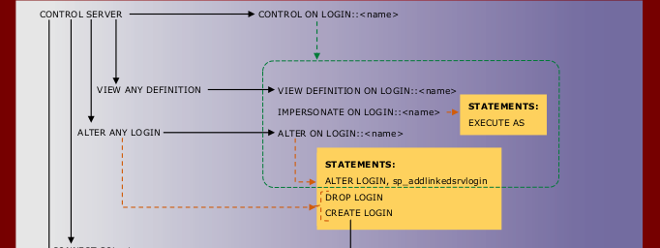
Mind the gap
Notes:
Do you see the problem here?
What do I need to DENY?

Slide 26
Deny DBA access to user schemas
Denies DBA access to business data
sp_foreachdb used in this step
CRUD removed from all user schemas
Excluding DBA utility database, tracedb
Notes:
Step 4. DENY DBA access to USER database schemas to prevent DBA access to data in USER databases.
This was one of the key requirements.
Management didn’t want DBAs to have any access to business data.
TRUE STORY: I revoked ALL access from MSSQL than Compliance said other database platforms allowed SELECT access. WTF?
I replied “You said you didn’t want DBAs to have access to business data.”
Does that make sense to you?
Do you want DBA selecting from the payroll or annual bonus table???
Just saying….

Slide 27
Drop DBA groups from sysadmin role
Drop existing DBA groups from sysadmin
Drop DBAs from sysadmin fixed server role
Execute as user that will not lose privileges
LOCAL, FAST_FORWARD cursor options
Cursors 70% faster with these options
Notes:
Step 5. Drop DBA groups from sysadmin server role
This script is 70% faster than last year’s script. Explain why.
Link to Aaron’s blog post and Summit talk. Slide.

Slide 28
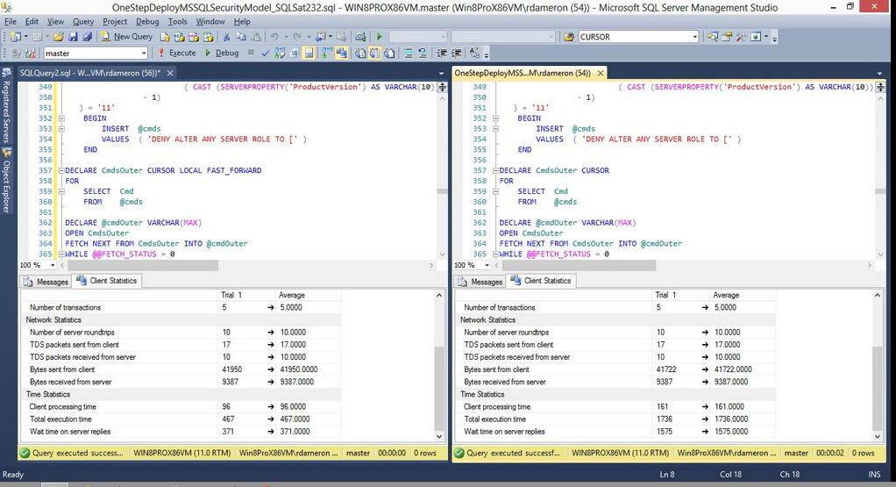
There be cursors here! LOCAL FAST_FORWARD
Notes:
Aaron Bertrand and Kevin Kline did a presentation at the last 2013 PASS Summit in Charlotte.
Ten Query Tuning Techniques Every SQL Programmer Should Know

Slide 29
Grant additional memberships
SQLAgentOperatorRole
db_ssisadmin
db_dtsadmin
Notes:
Step 6. Grant DBAs membership to SQLAgentOperatorRole, db_ssisadmin, db_dtsadmin
Added these additional privileges in msdb as DBAs reported issues getting work done.
If you don’t have SQLAgentOperatorRole when you are not sysadmin, SQL Agent is not visible in SSMS.
The other two memberships are needed to manage SSIS and DTS(sadly) packages.

Slide 30
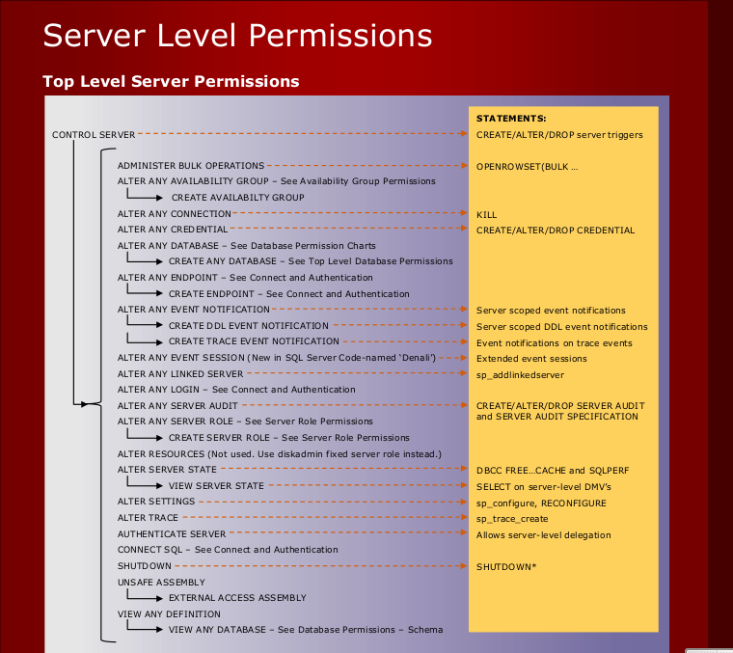
A picture is worth a thousand perms
Notes:
This was a huge help in understanding security model
Highly recommend it. I have the link to this poster at the end of the deck.
Concentrated on server and database perms
Very helpful when writing scripts
CONTROL SERVER and a few DENYs seems to be working well.
Search terms are “sql server permissions poster”.

Slide 31

Demo
https://imgur.com/i9MnL3J.jpg
Notes:
Run time depends on number of databases and schema on server
But before I do the demo I have some required reading for you.

Slide 32
Script Disclaimer
For people who need to be told this sort of thing:
Never trust any script, including those that you find here, until you understand exactly what it does and how it will act on your systems. Always check the script on a test system or Virtual Machine, not a production system. Yes, there are always multiple ways to do things, and this script may not work in every situation, for everything. It’s just a script, people. All scripts on this site are performed by a professional stunt driver on a closed course. Your mileage may vary. Void where prohibited. Offer good for a limited time only. Keep out of reach of small children. Do not operate heavy machinery while using this script. If you experience blurry vision, indigestion or diarrhea during the operation of this script, see a physician immediately.
Notes:
Buck Woody’s awesome script disclaimer.
Self-explanatory

Slide 33


The Wisdom of Buck Woody
Notes:
Serious Buck and not so serious Buck

Slide 34
Recap
DBAs don’t always need sysadmin
CONTROL SERVER allows DENY
Configurable security model
One script to lock down databases
More secure database servers
Happy auditors
Unhappy hackers, hopefully.
Notes:
Summary:
If you leave remembering only one thing...
CONTROL SERVER and DENY makes a Virtual Sysadmin more acceptable to your auditors.
Your DBAs don’t show up in the sysadmin fixed server role.

Slide 35
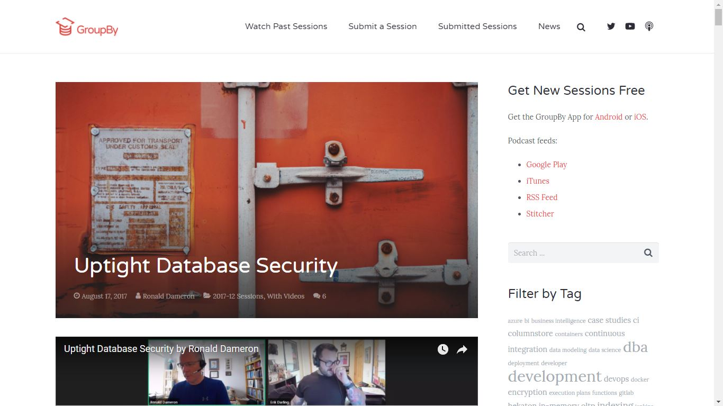
GroupBy
https://groupby.org/conference-session-abstracts/uptight-database-security/
Notes:
If you want to watch this session again.
https://groupby.org/conference-session-abstracts/uptight-database-security/

Slide 36
Resources
Permissions posters
http://social.technet.microsoft.com/wiki/contents/articles/11842.sql-server-database-engine-permission-posters.aspx
http://goo.gl/alHLc
PASS Summit 2012
The Evolution of Security in SQL Server 2012
PASS Summit 2010
Si Se Puede! Achieving Separation of Duties with SQL Server
With Cyber-Ark, hackers have no ‘privileges’
http://www.timesofisrael.com/with-cyber-ark-hackers-have-no-privileges/

Slide 37
Resources
Sysadmin and CONTROL SERVER
http://www.insidesql.org/blogs/andreaswolter/
http://www.insidesql.org/blogs/andreaswolter/2013/08/control-server-vs-sysadmin-sa-permissions-privilege-escalation-caveats
Ten Query Tuning Techniques Every SQL Programmer Should Know
http://youtu.be/XUCxQkFoqpw
http://krebsonsecurity.com/2015/02/china-to-blame-in-anthem-hack/
http://sqlmag.com/database-security/using-sql-server-permissions
Notes:
Andreas Wolter, MCM

Slide 38

Any questions?
Ronald Dameron
@RonDBA
ron.dameron@gmail.com

Slide 39

Any questions?
Ronald Dameron
@RonDBA
ron.dameron@gmail.com

Slide 40

Any questions?
http://smeagol92055.files.wordpress.com/2013/08/chrisdoohan.jpg
Ronald Dameron
@RonDBA
ron.dameron@gmail.com
Notes:
That’s the original Scotty’s son in the background.
James Doohan’s son Chris Doohan had a cameo in Star Trek reboot movie.
Thank you for coming.
Any feedback? Please be brutally honest.

